Slide 1


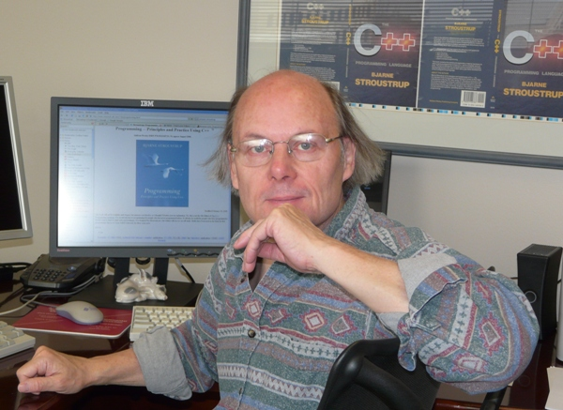
Open Pattern Matching for C++
Yuriy Solodkyy • Gabriel Dos Reis • Bjarne Stroustrup
Texas A&M University
Microsoft
October 27, 2013
GPCE’13, Indianápolis, IN
Partially supported by NSF grants: CCF-0702765, CCF-1043084, CCF-1150055
http://parasol.tamu.edu/mach7/
Notes:
Hi, my name is Yuriy and today I would like to present the work we did in collaboration with Dr. Dos Reis and Dr. Stroustrup, which continues our research on pattern matching for C++.

Slide 2
Mach7
A library solution to pattern matching in C++
Implemented in standard C++ (mostly 03, but benefits from 11)
Open to new patterns
All patterns are user-definable
First-class patterns
Patterns can be saved in variables and passed to functions
Type safe
Incorrect application is manifested at compile time
Non-intrusive
Can be applied retroactively
Efficient
Works on top of an efficient type switch construct
Faster than existing alternatives to open pattern matching in C++
Notes:
Our Mach7 library provides an open solution to pattern matching in standard C++, by making all the patterns in the library user-definable. The patterns are first-class citizens, which can be saved in variables and passed into functions. The solution is also type safe where incorrect pattern applications are reported at compile time. The solution is non-intrusive and can be applied retroactively. It builds on top of our efficient type switch construct and provides a pattern-matching solution that is faster than existing alternatives to open pattern matching in C++.

Slide 3
Introduction
What is a pattern?
a term representing an immediate predicate on an implicit argument
What is pattern matching?
a way of checking the structure of data and decomposing it into subcomponents
Examples of patterns
Wildcards, Variables, Values, Regular Expressions, Terms of the above etc.
Notes:
So what is a pattern? Languages with the closed set of patterns usually define them inductively by enumerating the list of primitive patterns and means of their composition. In a fully open setting by pattern we mean any term representing an immediate predicate on an implicit argument. Implicitness of the argument is what sets apart pattern from lambda-predicates of C++11.
Similarly to other languages, by pattern matching we mean a way of checking the structure of run-time values and decomposing them into subcomponents. The typical examples of patterns are wildcards, variables, regular expressions, tree patterns etc.

Slide 4
Example: Case Analysis in FP
+
*
6
7
2
exp ::= val | exp + exp | exp - exp | exp * exp | exp / exp
type expr =
Value of int
| Plus of expr * expr
| Minus of expr * expr
| ...
;;
let rec eval e =
match e with
Value v -> v
| Plus(a,b) -> (eval a)+(eval b)
| Minus(a,b)-> (eval a)-(eval b)
| ...
;;
Pros
Elegant
Intuitive
Extensibility of functions
Checked
redundancy
completeness
Local reasoning
Relational
Cons
No extensibility of data
Not suitable for classes:
Variants are closed & disjoint
Classes are extensible & hierarchical
Notes:
To give examples of patterns and pattern matching, imagine that you would like to implement an interpreter (or calculator) of a simple expression language represented by the following grammar. In functional languages, a term in such language will typically be represented with a recursive Algebraic Data Type (ADT) with variants corresponding to production rules. Functional languages then implement various operations on expression terms (like evaluation, printing or transformation) by simple case analysis on the variants with variables used to bind to corresponding subcomponents. An evaluation function, for example, is a simple recursion that follows the structure of the term.

Slide 5
Example: Nested Matching
+
*
6
7
2
exp ::= val | exp + exp | exp - exp | exp * exp | exp / exp
xa + xb → x(a+b)
let collect e =
match e with
| Plus(Times(x1,a), Times(x2,b)) when x1=x2
-> Times(x1,Plus(a,b))
| Plus(Times(a,x1), Times(b,x2)) when x1=x2
-> Times(Plus(a,b),x1)
| e -> e
;;
Notes:
Variables are not the only entities that can be bound to subcomponents and other patterns can be used instead to check the structure of those subcomponents. This leads to nesting of patterns as demonstrated here with function collect that extracts common factor from a sum. This is also where implicitness of the argument makes the solution less verbose than same solution expressed with lambda functions.

Slide 6
Example: Relational Matching
+
*
6
7
2
exp ::= val | exp + exp | exp - exp | exp * exp | exp / exp
let rec equal e1 e2 =
match (e1,e2) with
| (Value(v1) , Value(v2) ) -> v1 == v2
| (Plus (a1, b1), Plus (a2, b2))
| (Minus (a1, b1), Minus (a2, b2))
| (Times (a1, b1), Times (a2, b2))
| (Divide(a1, b1), Divide(a2, b2))
-> (equal a1 a2) && (equal b1 b2)
| _ -> false
;;
Notes:
The nesting of patterns can also be used to establish relations between multiple values. In a canonical example all the arguments are explicitly placed into a tuple, which is then decomposed with tuples of patterns.

Slide 7
Object-Oriented Alternatives?
Case Analysis
Virtual functions
Intrusive, control inversion, non-local reasoning
Visitor Design Pattern
Intrusive, control inversion, hard to teach
Nested Matching
Nested if-statements
Verbose
Relational Matching
Double dispatch
Intrusive, control inversion, hard to teach
Notes:
Object-oriented languages, where variants are often represented with derived classes, usually don’t provide such expressive facilities. The case analysis is usually performed either with dedicated virtual functions or a reusable visitor design pattern. Both are intrusive, introduce control inversion and potentially inhibit local reasoning. Visitors are also notoriously hard to teach to novices. In the absence of dedicated predicates, nested matching is usually explicit via nested if statements, which is verbose. Relational matching is often achieved with double dispatch, which bears all the problem of the visitor design pattern it is based on.

Slide 8
Why Pattern Matching?
void rotate_left(rbtree t, node n) {
node r = n->right;
replace_node(t, n, r);
n->right = r->left;
if (r->left != NULL) {
r->left->parent = n;
}
r->left = n;
n->parent = r;
}
void rotate_right(rbtree t, node n) {
node L = n->left;
replace_node(t, n, L);
n->left = L->right;
if (L->right != NULL) {
L->right->parent = n;
}
L->right = n;
n->parent = L;
}
void replace_node(rbtree t, node oldn, node newn) {
if (oldn->parent == NULL) {
t->root = newn;
} else {
if (oldn == oldn->parent->left)
oldn->parent->left = newn;
else
oldn->parent->right = newn;
}
if (newn != NULL) {
newn->parent = oldn->parent;
}
}
void rbtree_insert(rbtree t, void* key, void* value, compare_func compare) {
node inserted_node = new_node(key, value, RED, NULL, NULL);
if (t->root == NULL) {
t->root = inserted_node;
} else {
node n = t->root;
while (1) {
int comp_result = compare(key, n->key);
if (comp_result == 0) {
n->value = value;
/* inserted_node isn't going to be used, don't leak it */
free (inserted_node);
return;
} else if (comp_result < 0) {
if (n->left == NULL) {
n->left = inserted_node;
break;
} else {
n = n->left;
}
} else {
assert (comp_result > 0);
if (n->right == NULL) {
n->right = inserted_node;
break;
} else {
n = n->right;
}
}
}
inserted_node->parent = n;
}
insert_case1(t, inserted_node);
verify_properties(t);
}
void insert_case1(rbtree t, node n) {
if (n->parent == NULL)
n->color = BLACK;
else
insert_case2(t, n);
}
void insert_case2(rbtree t, node n) {
if (node_color(n->parent) == BLACK)
return; /* Tree is still valid */
else
insert_case3(t, n);
}
void insert_case3(rbtree t, node n) {
if (node_color(uncle(n)) == RED) {
n->parent->color = BLACK;
uncle(n)->color = BLACK;
grandparent(n)->color = RED;
insert_case1(t, grandparent(n));
} else {
insert_case4(t, n);
}
}
void insert_case4(rbtree t, node n) {
if (n == n->parent->right && n->parent == grandparent(n)->left) {
rotate_left(t, n->parent);
n = n->left;
} else if (n == n->parent->left && n->parent == grandparent(n)->right) {
rotate_right(t, n->parent);
n = n->right;
}
insert_case5(t, n);
}
void insert_case5(rbtree t, node n) {
n->parent->color = BLACK;
grandparent(n)->color = RED;
if (n == n->parent->left && n->parent == grandparent(n)->left) {
rotate_right(t, grandparent(n));
} else {
assert (n == n->parent->right && n->parent == grandparent(n)->right);
rotate_left(t, grandparent(n));
}
}
type color = R | B
type 'a tree = E | T of color * 'a tree * 'a * 'a tree
(**color * 'a tree * 'a * 'a tree->'a tree*)
let balance = function
| B, T(R, T(R,a,x,b), y, c), z, d
| B, T(R, a, x, T(R,b,y,c)), z, d
| B, a, x, T(R, T(R,b,y,c), z, d)
| B, a, x, T(R, b, y, T(R,c,z,d))
-> T(R, T(B,a,x,b), y, T(B,c,z,d))
| col, a, x, b -> T(col, a, x, b)
(** val insert : 'a -> 'a tree -> 'a tree *)
let insert x s =
let rec ins = function
| E -> T(R,E,x,E)
| T(col,a,y,b) as s ->
if x < y then balance(col, ins a, y, b) else
if x > y then balance(col, a, y, ins b) else s
in let T(_,a,y,b) = ins s in T(B,a,y,b)
Functional Solution to Red-Black Tree Insertion vs. Imperative
Notes:
So why bring pattern matching into an object-oriented language? Because the code for many applications is so notoriously shorter and easier to understand and maintain that people often opt for functional languages for certain kind of applications just because of pattern matching. The example here demonstrates a complete implementation of insertion into a red-black tree in a functional language and an incomplete implementation of the same functionality in an imperative language. Which of these would you expect to have more bugs?

Slide 9
Design Goals & Criteria
Design Ideals
Simple/Intuitive
Easy to teach
Direct show of intent
Checked
Non-intrusive
Open with respect to:
Patterns
Objects
Design Criteria
Work for C++ object model
Built-in & user-defined types
Multiple inheritance
Dynamic linking
Comparable or faster than workarounds
Visitor Design Pattern
Closed switch
Patterns as Objects
Notes:
An ultimate language feature of bringing pattern matching into C++ would have to satisfy certain design criteria and ideally meat some goals. Following the ideals of D&E book for C++, the feature would have to support the existing C++ object model, i.e. be able to deal with multiple inheritance, work in the presence of dynamic linking, be applicable to both user-defined and built-in types etc. To be adopted, it will also have to be comparable or faster than any known workarounds.
Its design ideals include intuitiveness, simplicity and ease of teaching present in the pattern matching facilities of functional languages. It should also be a direct show of intent and checkable (if that can be done without sacrificing the openness). The important ideal we would like to achieve in the light of what we could do with Mach7 library is to maintain openness of both set of patterns as well as set of classes analyzed.

Slide 10
Mach7: Structural Decomposition
OCaml
type expr =
Value of int
| Plus of expr * expr
| Minus of expr * expr
| Times of expr * expr
| Divide of expr * expr ;;
let rec eval e =
match e with
Value v -> v
| Plus (a,b) -> (eval a) + (eval b)
| Minus (a,b) -> (eval a) - (eval b)
| Times (a,b) -> (eval a) * (eval b)
| Divide(a,b) -> (eval a) / (eval b) ;;
Bindings
template <> class bindings<Value>
{ Members(Value::value); };
template <> class bindings<Plus>
{ Members(Plus::e1,Plus::e2); };
template <> class bindings<Minus>
{ Members(Minus::e1,Minus::e2); };
template <> class bindings<Times>
{ Members(Times::e1,Times::e2); };
template <> class bindings<Divide>
{ Members(Divide::e1,Divide::e2);};
C++
class Expr { virtual ~Expr(); };
class Value : Expr { int value; };
class Plus : Expr { Expr& e1; Expr& e2; };
class Minus : Expr { Expr& e1; Expr& e2; };
class Times : Expr { Expr& e1; Expr& e2; };
class Divide: Expr { Expr& e1; Expr& e2; };
int eval(const Expr* e) {
var<int> n; var<const Expr*> a,b;
Match(e)
Case(C<Value> (n)) return n;
Case(C<Plus> (a,b)) return eval(a)+eval(b);
Case(C<Minus> (a,b)) return eval(a)-eval(b);
Case(C<Times> (a,b)) return eval(a)*eval(b);
Case(C<Divide>(a,b)) return eval(a)/eval(b);
EndMatch
}
Notes:
Coming back to our expression language, here is almost everything the user has to write to implement a fully functional evaluator of expression terms in Mach7 side compared with the original OCaml code. It is also as efficient, while does not assume a closed world. The only missing bit is binding definitions, which tell the library how to decompose an object of a given type. These definitions are made once for the entire hierarchy, can be parameterized and are made retroactively. They are non-intrusive and fully respect encapsulation rules of C++.
The structural decomposition in Mach7 is achieved with the help of C<> template representing a constructor pattern. It can be composed of other patterns, like the explicit variable patterns here, and knows how to use the bindings to access corresponding subcomponents.
Similarly to OCaml solution, our solution is:
general
concise and direct
avoids control inversion
open to class extensions
intuitive and thus easier to teach

Slide 11
Mach7: Nested Matching
xa + xb → x(a+b)
let collect e =
match e with
Plus(Times(x1,a), Times(x2,b))
when x1=x2 -> Times(x1,Plus(a,b))
| Plus(Times(a,x1), Times(b,x2))
when x1=x2 -> Times(Plus(a,b),x1)
| e -> e
;;
Language solution
Predefined set of patterns
Implicit variable introduction
Linearity
const Expr* collect(const Expr* e) {
var<const Expr*> x, a, b;
Match(e)
Case(C<Plus>(C<Times>(x,a),C<Times>(+x,b)))
return new Times(x, new Plus(a,b));
Case(C<Plus>(C<Times>(a,x),C<Times>(b,+x)))
return new Times(new Plus(a,b), x);
EndMatch
return e;
}
Library solution
All patterns are user-defined
Explicit variable introduction
Equivalence combinator
Notes:
The nesting of patterns in Mach7 is further demonstrated in our implementation of the collect function. Remember that unlike solution in OCaml, this is a library solution where all the patterns are user-definable. It has the negative implication that the variable patterns have to be explicitly introduced, however it also allows us to create custom patterns and pattern combinators which can further shorten the code. This is the case in this example, where we use a user-defined equivalence combinator + that turns binding uses of a variable pattern into non-binding ones.

Slide 12
Mach7: Relational Matching
let rec equal e1 e2 =
match (e1,e2) with
(Value(v1), Value(v2)) -> v1 == v2
| (Plus (a1, b1), Plus (a2, b2))
| (Minus (a1, b1), Minus (a2, b2))
| (Times (a1, b1), Times (a2, b2))
| (Divide(a1, b1), Divide(a2, b2))
-> (equal a1 a2) && (equal b1 b2)
| _ -> false
;;
Single scrutiny
Closed world
Exhaustiveness check
Redundancy check
Compiler optimizations
bool operator==(const Expr& e1, const Expr& e2) {
var<int> n; var<const Expr&> a, b;
Match(e1 , e2 )
Case(C<Value> (n) , C<Value> (+n) ) return true;
Case(C<Plus> (a, b), C<Plus> (+a, +b)) return true;
Case(C<Minus> (a, b), C<Minus> (+a, +b)) return true;
Case(C<Times> (a, b), C<Times> (+a, +b)) return true;
Case(C<Divide>(a, b), C<Divide>(+a, +b)) return true;
EndMatch
return false;
}
Multiple scrutiny
Open world
Open to new patterns & combinators
Open to new classes
Notes:
Mach7’s approach to relational matching is slightly unorthodox as instead of wrapping multiple arguments into tuples we provide a Match statement capable of taking multiple arguments. This is done intentionally to allow patterns that might query the dynamic type of the subject to benefit from the underlain type switch. Unlike OCaml’s solution, our solution is also fully open as it allows for both new patterns and pattern combinators as well as is open to new classes, including those linked dynamically. Note also how the use of equivalence combinator + actually shortens the code in comparison to OCaml’s code with guards.

Slide 13
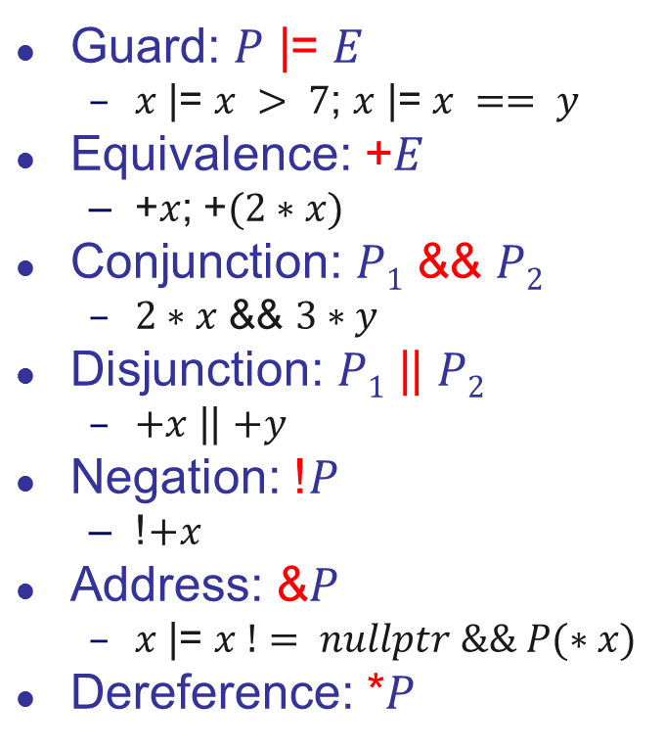
Mach7: Pattern Combinators
Operators for:
creating new patterns
modifying existing ones
combining patterns and lazy expressions
Guard: $P$ |= $E$
$x$ |= $x > 7$; $x$ |= $x == y$
Equivalence: +$E$
+$x$; +$(2∗x)$
Conjunction: $P1$ && $P2$
$2∗x$ && $3∗y$
Disjunction: $P1$ || $P2$
$+x$ || $+y$
Negation: !$P$
!$+x$
Address: &$P$
$x$ |= $x != nullptr \&\& P(∗x)$
Dereference: *$P$
Notes:
The equivalence combinator is only one of the pattern combinators commonly used in other languages (e.g. Thorn, Grace). Pattern combinators constitute operators for creating new patterns and modifying the meaning of existing ones. A guard combinator, for example, combines a pattern with a lazily evaluated guard into a guard pattern. Similarly, conjunction, disjunction and negation combinators allow one to compose patterns logically. Mach7 also introduces a few combinators specific to C++, which help deal with pointers.

Slide 14
Mach7: Balancing Red-Black Tree
class T{ enum color{black,red} col; T* left; K key; T* right; };
T* balance(T::color clr, T* l, const K& key, T* r)
{
const T::color B = T::black, R = T::red;
var<T*> a, b, c, d; var<K&> x, y, z; T::color col;
Match(clr, l, key, r)
{
Case(B, C<T>(R, C<T>(R, a, x, b), y, c), z, d) return ...;
Case(B, C<T>(R, a, x, C<T>(R, b, y, c)), z, d) return ...;
Case(B, a, x, C<T>(R, C<T>(R, b, y, c), z, d)) return ...;
Case(B, a, x, C<T>(R, b, y, C<T>(R, c, z, d))) return ...;
Case(col, a, x, b) return new T{col, a, x, b};
}
EndMatch
}
Where ... ≡ new T{R, new T{B,a,x,b}, y, new T{B,c,z,d}};
Notes:
Combined together, you can see that our open patterns allow us to express the functional solution to balancing red-black trees as tersely as it is known in the functional community.

Slide 15
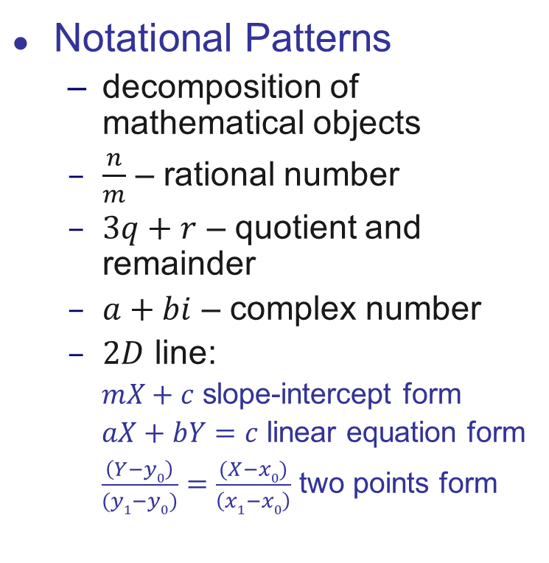
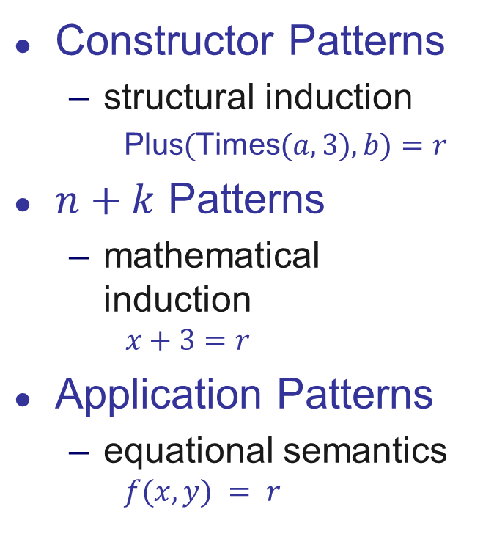
Mach7: Algebraic Decomposition
Constructor Patterns
structural induction
Plus$($Times$(a,3),b)=r$
$n+k$ Patterns
mathematical induction
$$x+3=r$$
Application Patterns
equational semantics
$$f(x,y) = r$$
Notational Patterns
decomposition of mathematical objects
$\frac{n}{m}$ – rational number
$3q+r$ – quotient and remainder
$a+bi$ – complex number
$2D$ line:
$mX+c$ slope-intercept form
$aX+bY=c$ linear equation form
$\frac{\left(Y−y0\right)}{(y1−y0)}=\frac{(X−x0)}{\left(x1−x0\right)}$ two points form
Notes:
Rod Burstall coined the idea of constructor patterns to explicitly facilitate structural induction on terms in order to be able to prove some properties about programs. With Peano construction of natural numbers, the idea was soon generalized to n+k patterns in order to facilitate the mathematical induction on natural numbers. Further attempts to generalize this idea included application patterns, which try to give such patterns equational semantics. The semantics of application patterns is obvious when the solution to corresponding equation is unique or absent, but when multiple solution exist, additional, often obscure and complicated rules, have to be put in place. Instead of trying to generalize algebraic decomposition along the equational route, we suggest to interpret them as notational patterns that help the programmer decompose parts of a mathematical objects with a well established notation known for such entity. For example, n/m is a common notation for rational numbers, which can be used to decompose an object representing a rational number into nominator and denominator. Similarly, a+bi is a common notation for decomposing complex numbers, while 3q+r can be used to obtain quotient and remainder of dividing a number by 3. More complex mathematical objects may have even more complex notations, like for example, 2D line that can be represented with slope-intercept, linear equation or two points form. Note that in the last 2 cases the equality sign is already embedded into the notation, making it hard to consider the equational semantics.

Slide 16
Mach7: Algebraic Decomposition
double power(double x, int n)
{
var<int> m;
Match(n)
{
Case(0) return 1.0;
Case(1) return x;
Case(2*m) return sqr(power(x,m));
Case(2*m+1) return x*sqr(power(x,m));
}
EndMatch
}
size_t gcd(const size_t a, const size_t b)
{
var<size_t> x;
Match(a,b)
Case(_,a) return a;
Case(_,a+x) return gcd(a,x);
Case(b+x,_) return gcd(b,x);
EndMatch
}
Equational reasoning
Since n is of integral type:
n=2*m → n must be even and m=n/2
n=2*m+1 → n must be odd and m=(n-1)/2
Type matters
b+x=a for unsigned x will match only when b > a
Notes:
Interestingly, the notational semantics of generalized n+k patterns allows us to express the useful cases of application patterns with their equational semantics. The following function implements fast algorithm for computing x^n and mimics almost one to one the mathematical definition from the book. The explicitness of variable pattern helps in this case as we can take the type of the underlying variable into account when providing the semantics of matching against a given expression. This allows us to reject matches for integral types and simply solve the equation when underlying type is a field. This is further demonstrated in the slow subtraction algorithm for GCD computation where for unsigned x the expression b+x will match the first argument a only when b > a.

Slide 17
Mach7: Other Patterns
var<int> n,m,y,d,m;
auto month = m |= m > 0 && m < 13; // Save pattern to variable
auto day = d |= d > 0 && d < 31; // Day pattern
Match(s)
{
Case(rex("([0-9]+)-([0-9]+)-([0-9]+)", 979)) // Local phone
Case(rex("([0-9]+)-([0-9]+)-([0-9]+)",
any({800,888,877,866,855}), n, m) // Toll-free phone
Case(rex("([0-9]{4})-([0-9]{2})-([0-9]{2})",
y, month, d |= d > 0 && d <= 31)) // Date
Otherwise() // Something else
}
EndMatch
All Patterns in the library are user-defined
Patterns can be saved in variables and passed to functions
Notes:
As we mentioned, the library does not rely on a set of pre-existing patterns and can be used with new patterns that are easy to create. Using the new regular expression class of C++11 we could quickly create a regular expression pattern that can be composed with other patterns and used inside the Match statement. The patterns can also be saved into variables as demonstrated here with month and day and then reused inside other patterns. The Match statement you see can be used to parse and check the string for being a local phone, a toll-free phone and a valid date.

Slide 18
Patterns as Objects
struct object { // root of the object class hierarchy
virtual bool operator==(const object&) const = 0;
};
struct pattern { // pattern interface
virtual bool match(const object&) = 0;
};
Run-time composition of patterns
Pros
Open patterns
First-class patterns
Dynamic composition
Cons
Intrusive
Type errors at run-time
Extremely slow
Notes:
The idea of open patterns is not new and has been explored before. In object-oriented languages it is usually based on two interfaces: object and pattern. The object interface is used to check equivalence of two values, while the pattern interface provides match function that is implemented by each specific pattern kind. The patterns in this case are composed at run-time and allow for dynamic composition of patterns based on user input.
The problem with this solution is that is intrusive as it assumes all the classes that participate in pattern matching to be derived from a single base class. Type errors are only discovered at run-time. Most importantly however, the approach is extremely slow in comparison to handcrafted solution, as we will see shortly.

Slide 19
Patterns as Expression Templates
template <typename... P>
struct some_pattern : std::tuple<P...> {
static_assert(conjunction<is_pattern<P>...>::value,“Not a pattern");
some_pattern(P&&... p);
template <typename S> struct accepted_type_for { typedef S type; };
template <typename S> bool operator()(const S& s) const;
};
Compile-time composition of patterns
Pros
Open patterns
First-class patterns
Non-intrusive
Type errors at compile-time
Cons
Compile-time composition
Notes:
Our patters are also implemented as objects, however these objects do not have to belong to any class hierarchy. Instead they all have to model a Pattern concept, which typically amounts to implementing a constructor taking sub-patterns, a type-function to benefit from type switching and an application operator implementing the actual matching logic.
The solution is non-intrusive as neither values nor patterns have to belong to a given class hierarchy. Incorrect applications of patterns to subjects or invalid pattern compositions are reported at compile time (mostly with nice messages from static_assert, but occasionally with cryptic ones). The main disadvantage in comparison to the “Patterns as Objects” approach is that because pattern composition happens at compile time, the patterns cannot be composed based on user input. This is the case however with most of the languages with predefined set of patterns, and is generally expected from a pattern matching mechanism of a language.

Slide 20
Pattern Matching Overhead
15% - percentage hand crafted code is faster by 15% - percentage pattern matching code is faster by
 |  | Patterns as Expr. Templ. |  |  |  |  | Patterns as Objects
 |  | G++ |  |  | Visual C++ |  | G++ |  |  | Visual C++
Test | Patterns | 4.5.2 | 4.6.1 | 4.7.2 | 10 | 11 | 4.5.2 | 4.6.1 | 4.7.2 | 10 | 11
factorial₀ | 1,v,_ | 15% | 13% | 17% | 85% | 35% | 347% | 408% | 419% | 2121% | 1788%
factorial₁ | 1,v | 0% | 6% | 0% | 83% | 21% | 410% | 519% | 504% | 2380% | 1812%
factorial₂ | 1,n+k | 7% | 9% | 6% | 78% | 18% | 797% | 911% | 803% | 3554% | 3057%
fibonacci | 1,n+k,_ | 17% | 2% | 2% | 62% | 15% | 340% | 431% | 395% | 2730% | 2597%
gcd₁ | v,n+k,+ | 21% | 25% | 25% | 309% | 179% | 1503% | 1333% | 1208% | 8876% | 7810%
gcd₂ | 1,n+k, | 5% | 13% | 19% | 373% | 303% | 962% | 1080% | 779% | 5332% | 4674%
gcd₃ | 1,v | 1% | 0% | 1% | 38% | 15% | 119% | 102% | 108% | 1575% | 1319%
lambdas | &,v,C,+ | 58% | 54% | 56% | 29% | 34% | 837% | 780% | 875% | 259% | 289%
power | 1,n+k | 10% | 8% | 13% | 50% | 6% | 291% | 337% | 338% | 1950% | 1648%
Our Solution
Previous Approaches
Notes:
To estimate the overhead of both approaches to pattern matching we compared a code written with patterns and an equivalent code without patterns implementing the same algorithm. As can be seen on the right, patterns implemented with “Patterns as objects” approach introduce significant overhead over the hand-crafted code. This is not the case with our approach, where the overhead is fairly small. In some cases, our approach even produced faster code, indicated in lighter blue font in the table.

Slide 21
Compilation Time Overhead
15% - handcrafted compilation is faster by 15% - pattern matching compilation is faster by
 |  | Patterns as Expr. Templ. |  |  | Patterns as Objects
 |  | G++ | Visual C++ |  | G++ | Visual C++
Test | Patterns | 4.7.2 | 10 | 11 | 4.7.2 | 10 | 11
factorial₀ | 1,v,_ | 1.65% | 1.65% | 2.95% | 7.10% | 10.00% | 10.68%
factorial₁ | 1,v | 2.46% | 1.60% | 10.92% | 7.14% | 0.00% | 1.37%
factorial₂ | 1,n+k | 2.87% | 3.15% | 3.01% | 8.93% | 4.05% | 3.83%
fibonacci | 1,n+k,_ | 3.66% | 1.60% | 2.95% | 11.31% | 4.03% | 1.37%
gcd₁ | v,n+k,+ | 4.07% | 4.68% | 0.91% | 9.94% | 2.05% | 8.05%
gcd₂ | 1,n+k, | 1.21% | 1.53% | 0.92% | 8.19% | 2.05% | 2.58%
gcd₃ | 1,v | 2.03% | 3.15% | 7.86% | 5.29% | 2.05% | 0.08%
lambdas | &,v,C,+ | 18.91% | 7.25% | 4.27% | 4.57% | 3.82% | 0.00%
power | 1,n+k | 2.00% | 6.40% | 3.92% | 8.14% | 0.13% | 4.02%
Notes:
Several people have also expressed their concerns that since our solution is based on templates, the compilation times will increase significantly. We measured the impact of compiling both approaches against compiling the hand-crafted code and did not find any significant increase in compilation times. This is expected as implementation of our patterns does not rely on complex meta-programming and in most of the cases amount to straightforward top-down instantiation of templates.

Slide 22



Multi-Argument Comparison
n is the number of subobjects in a class hierarchy of arguments
Memory:
$$n^{N}+n^{N−1}+…+n^{2}+n$$
$$\left(2N+3\right)n^{N}+N+7$$
$$n^{N}+Nn+N$$
GCC 4.5.2
GCC 4.6.1
GCC 4.7.2
Visual C++ 10
Visual C++ 11
Notes:
Finally, in application to relational matching we wanted to see how our solution compares to visitor-based implementations (double, triple, quadruple dispatch) as well as our own implementation of multi-methods for C++, which enable such relational checks.
It is easy to see that the solution based on the visitor design pattern was generally slower than the same solution based on pattern matching, which in turn was slower than the multi-methods based solution.
While all the solutions used the amount of memory of the same magnitude O(n^{N}), the coefficients were quite different. Contrary to the common belief, multi-methods take less memory than the equivalent solution based on visitor design pattern. While type switch was using the most memory, the values are written for the worst case: the size of type switch grows proportionally to the number of actual argument pairs seen, while both N-Dispatch and open multi-methods essentially pre-allocate for the worst case all the time.

Slide 23
Conclusions
Open Pattern Matching for C++:
Open (w.r.t. Patterns & Objects analyzed)
Faster than alternatives (visitors, patterns as objects)
Non-intrusive
Mach7:
A Library Solution
Open Sourced under BSD license: http://parasol.tamu.edu/mach7/
Currently works for G++ 4.4+ and Visual C++ 2010+
A Roadmap for Future Language Solution
A baseline for features
A baseline for performance
Transition for implementations
A hope that future Object-Oriented languages will consider including support for pattern matching a-priori instead of a-posteriori
Notes:
In conclusion, we presented a solution to open pattern matching in C++, which allows for both openness of patterns and objects being analyzed. It is faster than alternatives and can be applied retroactively. The current solution is a library implemented in standard C++ that is available as open source under BSD license.
The current solution is already competitive & we expect the forthcoming built-in support to be even better. In the meantime we plan to use it as a base line for features and performance evaluation of the actual language solution. We hope that experiences obtained in this implementation will also convince authors of future object-oriented languages to consider including pattern matching a-priory as many of the techniques used are applicable to broader set of languages.

Slide 24

Thank You!
http://parasol.tamu.edu/mach7/
Acknowledgements
Abe Skolnik
Jason Wilkins
Michael Lopez
Jasson Casey
Peter Pirkelbauer
Andrew Sutton
Karel Driesen
Emil 'Skeen' Madsen
Microsoft
Notes:
We would like to acknowledge numerous individuals who helped with this publication, the library and evaluation of its use. I would also like to acknowledge my new employer, Microsoft, for accommodating this travel.

